Slide 1

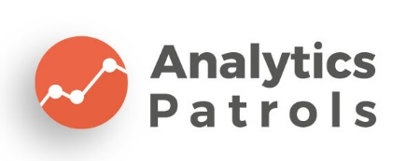
Future of Mobility with AI
Sayed A. Omar

Slide 2
Agenda
What is Human Intelligence
What is AI
AI, ML and DL
Types of ML problems
Where is AI?
From smart to super-smart
Business Cases

Slide 3
What is Human Intelligence?

Slide 4

What is AI?
is any computer program that does something smart. It can be a stack of a complex statistical model or if-then statements.

Slide 5
AI Vs. ML Vs. DL

Slide 6
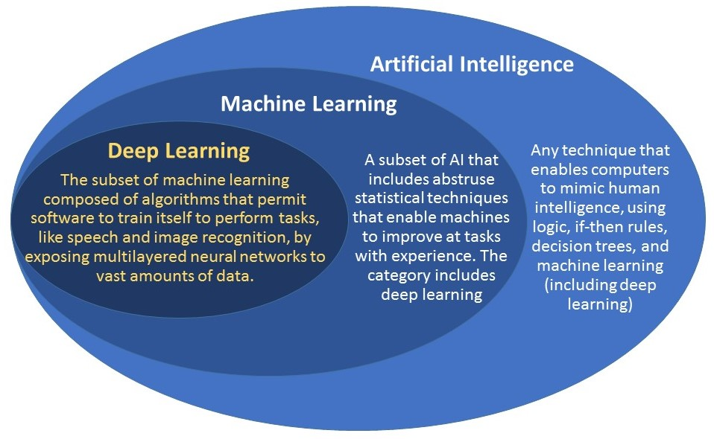
Notes:
6

Slide 7
Types of ML Problems
Supervised Learning
Reinforcement Learning
Unsupervised Learning

Slide 8
Where is AI?

Slide 9

Computer Vision Apps

Slide 10
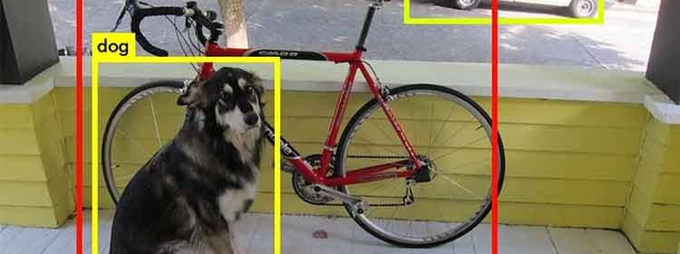
Object Detection

Slide 11
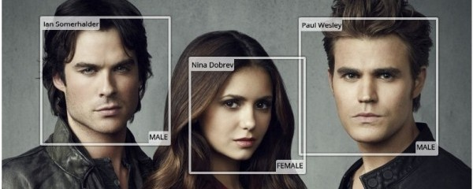
Face Detection & Connection

Slide 12

Economics Applications

Slide 13

Market Analytics

Slide 14
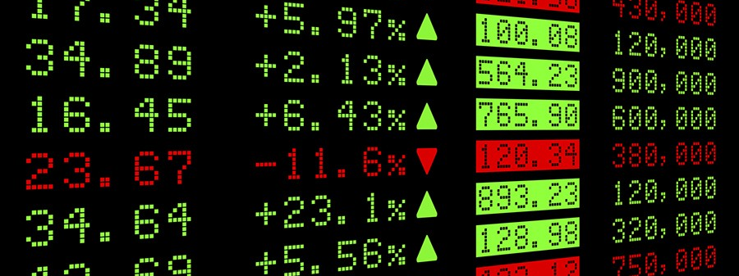
Stock Market Prediction

Slide 15
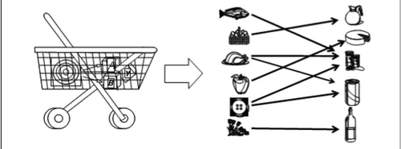
Association Rules Apps

Slide 16

Sentiment Analysis Apps

Slide 17
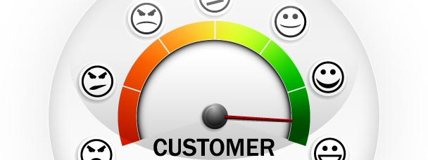
Customer Relationship & Satisfaction

Slide 18
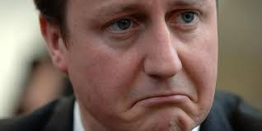
Current Mode

Slide 19

Recommendation Apps

Slide 20


Video Recommendation

Slide 21
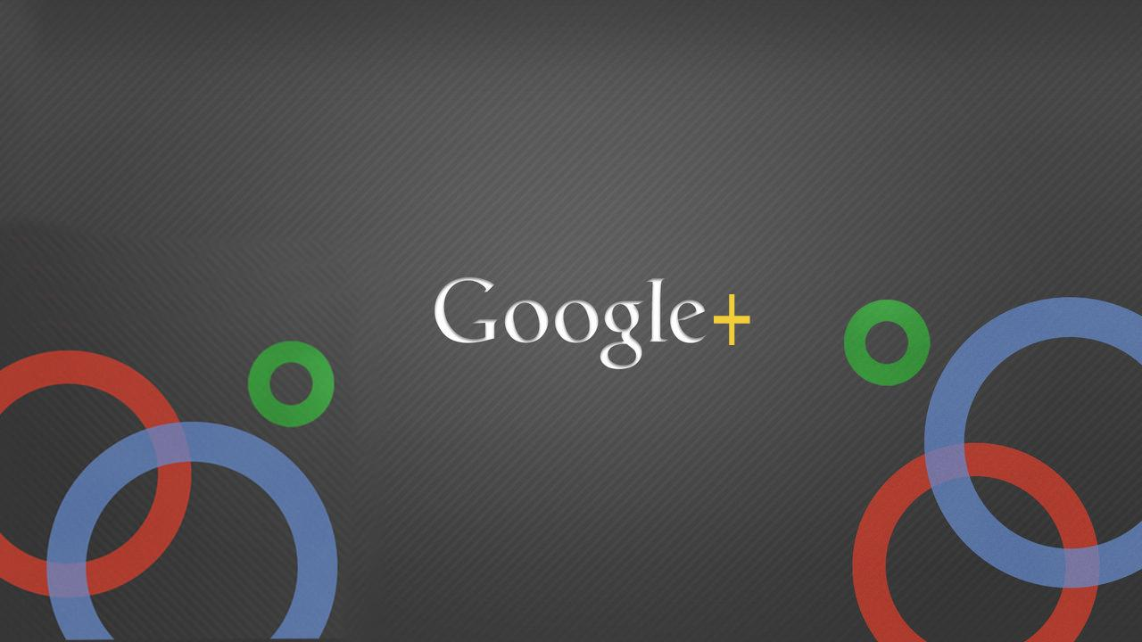

Friends & Pages Suggestions

Slide 22


Products Suggestion

Slide 23


Online Ads Platforms

Slide 24
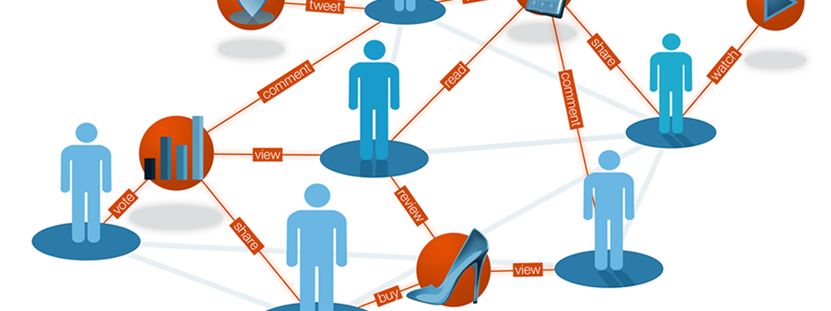
User Behavior Analytics

Slide 25
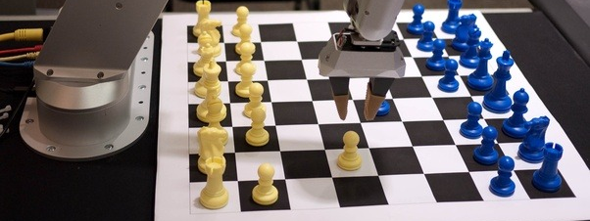
Playing Games

Slide 26
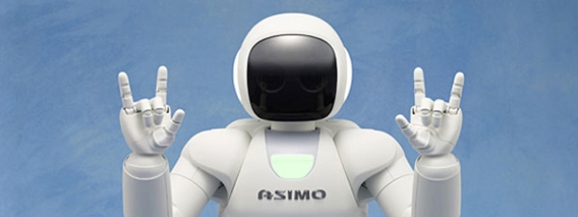
Robots

Slide 27

Medical Diagnosis Applications

Slide 28

Heart attack detection

Slide 29

Blood Analysis Results

Slide 30
From smart to super-smart
AI chips
Augmented Reality
Personal Assistants
Chat Bots

Slide 31
Business Cases

Slide 32
Automate customer feedback analysis
Industry: Entertainment
Client: International Game Developer
Challenge: Costly and time consuming customer feedback analysis
Solution: NLP solution for customer feedback analysis automation
Technologies and tools: Python, Kafka, Elasticsearch, Celery
Result : The Client saw significant improvement both in the working process of social research department and in the quality of insights within a couple of months after the deployment
https://indatalabs.com/resources

Slide 33
Increasing YouTube Ads Efficiency with Influencer Audience Analysis
Client: International Game Developer
Industry: Game Development
Challenge: Choose the best ads channels on YouTube
Solution: Influencer Search, YouTube channels analysis to discover potential audience
Result : By showing relevant ads to the right audience the client improved CTR and reduced CPA by 45%.
https://indatalabs.com/resources

Slide 34
Movie recommender system for Smart TV app
Industry: Digital entertainment
Client: Leading premium video on-demand service
Challenge: Deliver fresh personalized Recommendations to every user
Solution: Custom recommender system powered by machine learning
Technologies and tools: Python, SQL, Spark, EngineX, Flusk-API, PostgreSQL, Spark Parket
Results :
Fresh Personalized Recommendation for each user
Users finds desired movies faster.
- The average number of unique scrolled-before-purchase film cards dropped by 25%
https://indatalabs.com/resources

Slide 35
Churn Prediction for Online Sports Betting Company
Client: Sports Betting Company
Challenge: Churn Reduction
Solution: Churn Prediction Solution
Service provided: Predictive Modeling
Technologies and tools: Python
Results :
- solution allows its customer to predict customer churn and take up necessary measures to prevent it.
- The company saw a 20% churn reduction within first three months after deployment.
https://indatalabs.com/resources

Slide 36



Thank You
Sayed A. Omar
01154447771
Sayed931
SayedOmar

